Slide 1

Graphics: OpenGL ES
Luke Scicluna

Slide 2


Layout
Introduction
Versions of OpenGL ES
Graphics Pipeline
Step-by-step coding example with further information

Slide 3

Introduction
OpenGL ES stands for Open Graphics Language for Embedded Systems .
Developed by Khronos Group and released initially 28 July 2003.
Intended for embedded devices such as smartphones, consoles, appliances and vehicles.
GLES is available on smartphones with both IOS and Android OS.
The OpenGL ES APIs (application programming interface) offer tools for rendering 2D and 3D graphics.

Slide 4
Differences between OpenGL and GLES
OpenGL ES is a subset of OpenGL.
GLES contains the base essentials of OpenGL API
GLES is created so that it can be implemented on devices with simpler, cheaper hardware and low power to run on batteries.
A significant difference between OpenGL and OpenGL ES is that OpenGL ES removed the need to bracket OpenGL library calls with glBegin and glEnd.

Slide 5

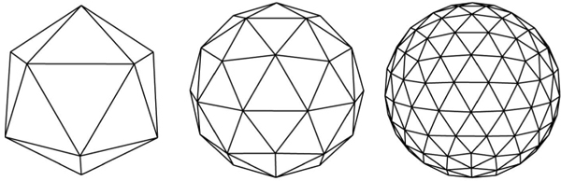
Applications of GLES

Slide 6
GLES Versions
OpenGL ES 1.0 and 1.1 were the first portable mobile graphics APIs.
OpenGL ES 2.0 exposed programmable shaders. It remains a prevalent API today, and still is the most widely available 3D graphics API and remains a solid choice to target the widest range of devices in the market.
OpenGL ES 3.0 - Enhanced Graphics and included multiple render targets, additional texturing capabilities, uniform buffers, instancing and transform feedback.
OpenGL ES 3.1 - Brought Compute to Mobile Graphics
OpenGL ES 3.2 - Added additional functionality based on the Android Extension Pack which brought the mobile API's functionality closer to OpenGL.

Slide 7
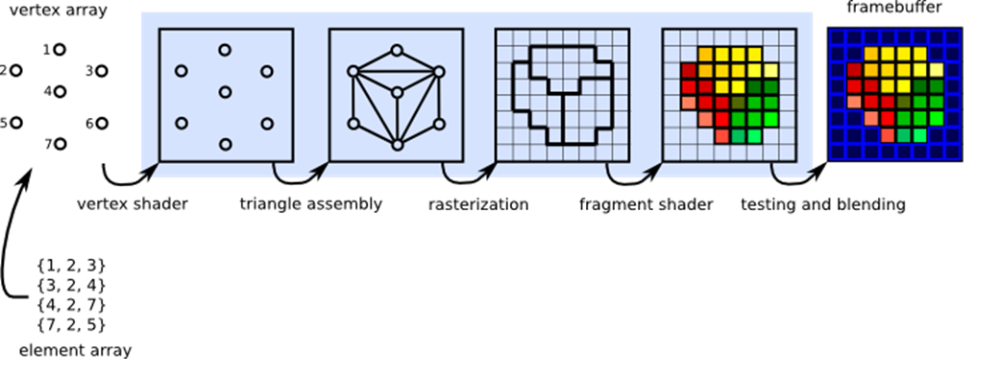
Graphics Pipeline

Slide 8
Surface View
Apps that use OpenGL ES have activities just like other applications.
OpenGL ES uses GLSurfaceView as well as TextView, Button and ListView.
GLSurfaceView is a specialized view where you can draw OpenGL ES graphics.

Slide 9
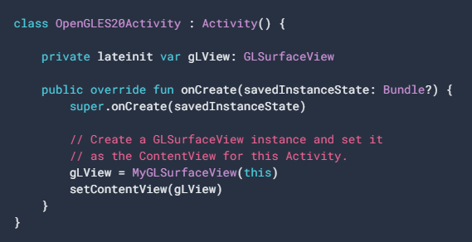
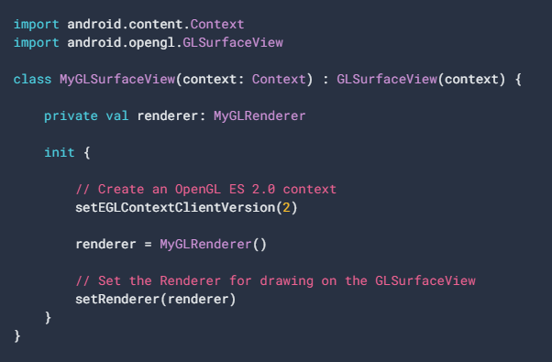
Surface View Code

Slide 10
Renderer Class
The GLSurfaceView.Renderer class controls what gets drawn on the GLSurfaceView.
There are three methods in a renderer to figure out what and how to draw on a GLSurfaceView :
onSurfaceCreated() - Called once to set up the view's OpenGL ES environment.
onDrawFrame()- Called for each redraw of the view.
onSurfaceChanged()- Called if the geometry of the view changes, for example when the device's screen orientation changes.

Slide 11
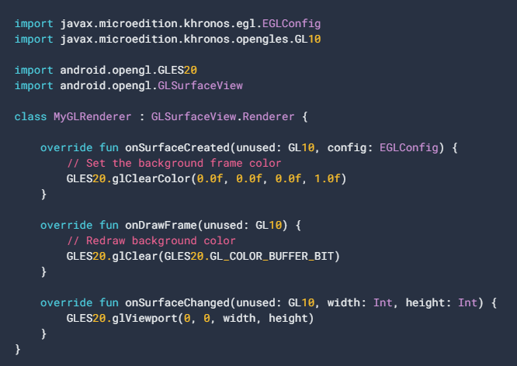
Renderer Class Code

Slide 12
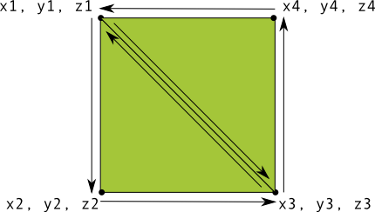
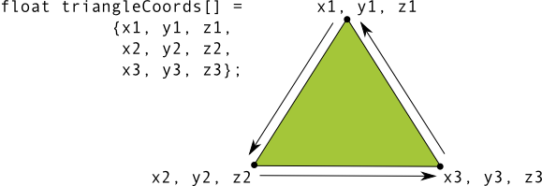
Defining Shapes

Slide 13
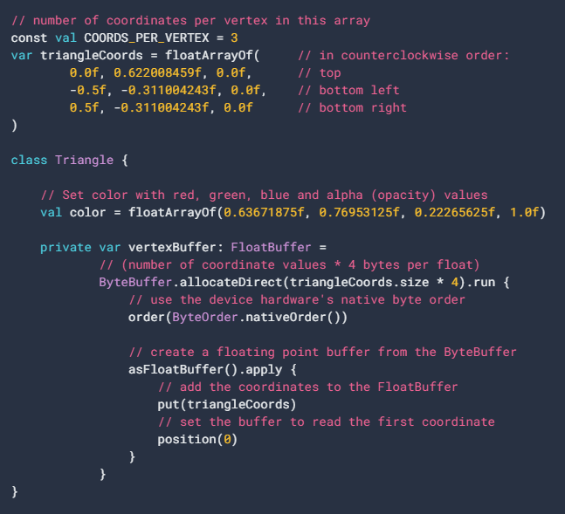
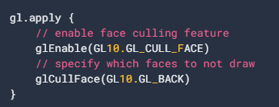
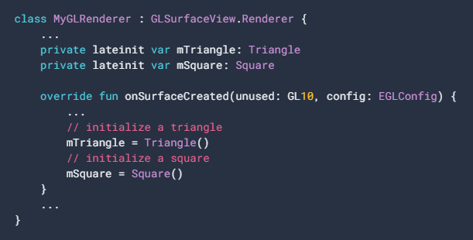
Defining a Triangle Code

Slide 14
Shaders
Vertex Shader - OpenGL ES graphics code for rendering the vertices of a shape.
Fragment Shader - OpenGL ES code for rendering the face of a shape with colors or textures.
Program - An OpenGL ES object that contains the shaders you want to use for drawing
Shaders contain OpenGL Shading Language (GLSL) code that must be compiled prior to using then in the OpenGL ES environment.

Slide 15
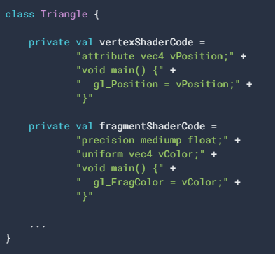
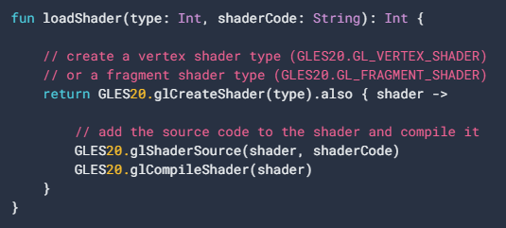
Shaders Code

Slide 16
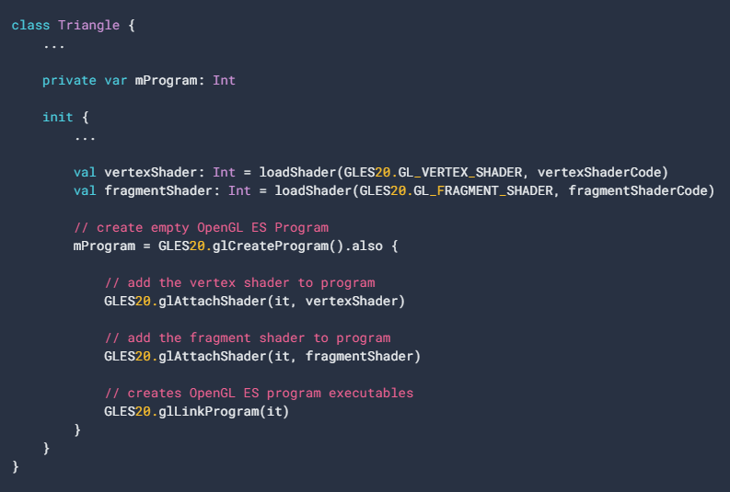
Shaders Code

Slide 17
Drawing the Shapes
The draw() method sets the position and color values to the shape’s vertex shader and fragment shader, and then executes the drawing function.
Since drawing options can vary by shape, it's a good idea to have your shape classes contain their own drawing logic.
Drawing the object just requires a call to the draw() method from the onDrawFrame() method.

Slide 18
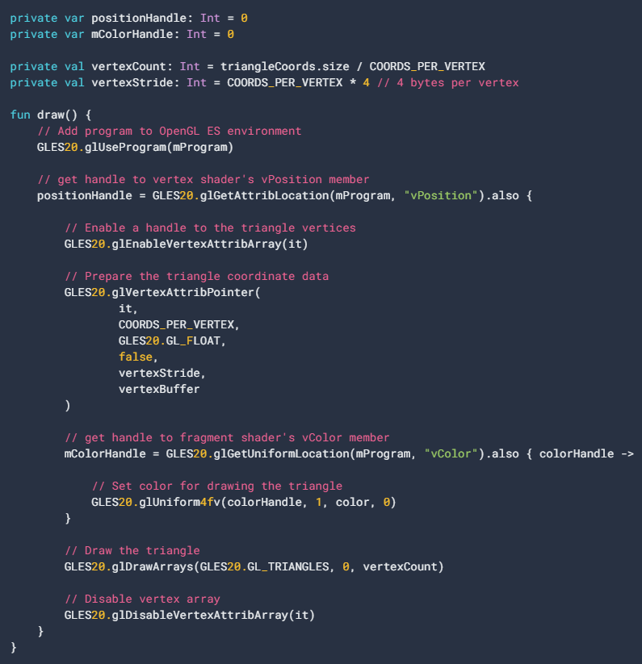
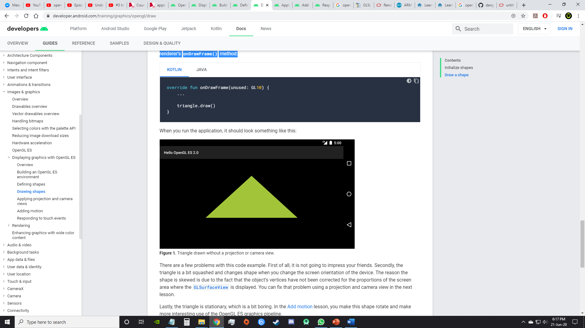
Draw() Code

Slide 19
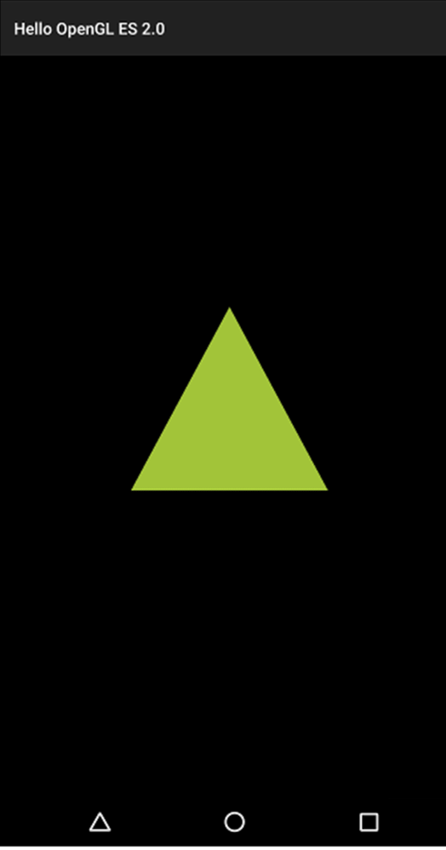
Result

Slide 20
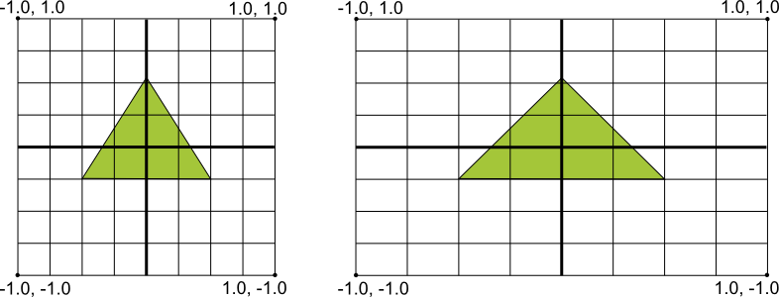
Mapping
OpenGL uses a uniform coordinate system.
Assumes the screen to be a perfect square.

Slide 21
Projection and Camera View
Projection and camera views display drawn objects in a way that resembles how physical objects are seen with our eyes.
This is done with mathematical transformations of the drawn object coordinates

Slide 22
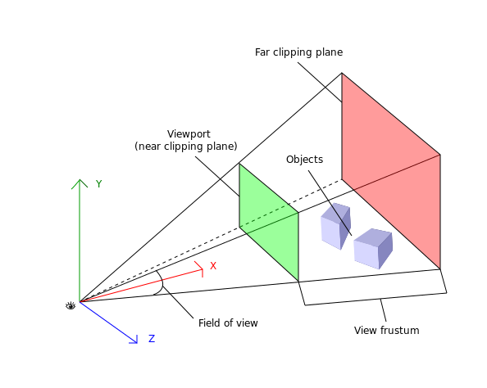
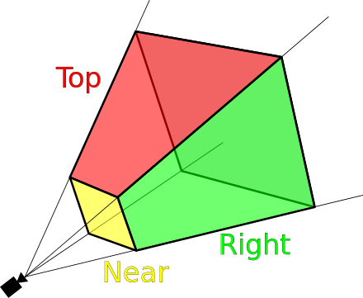
Projection and Camera View

Slide 23
Defining a Projection
This transformation adjusts the coordinates of drawn objects based on the width and height of the GLSurfaceView they are displayed on.
A projection transformation can only be calculated when the onSurfaceChanged() method is called.
The data for a projection transformation is calculated in the onSurfaceChanged() method.
The Matrix.frustum() method can be used to populate a projection transformation Matrix.

Slide 24
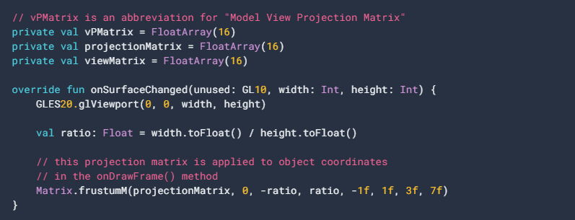
Projection Code

Slide 25
Define a Camera View
This transformation adjusts the coordinates of drawn objects based on a virtual camera position.
The camera view transformation can change dynamically based on the user's actions or the application’s function.
The camera view transformation is calculated using the Matrix.setLookAtM() method and then combined with the previously calculated projection matrix.

Slide 26
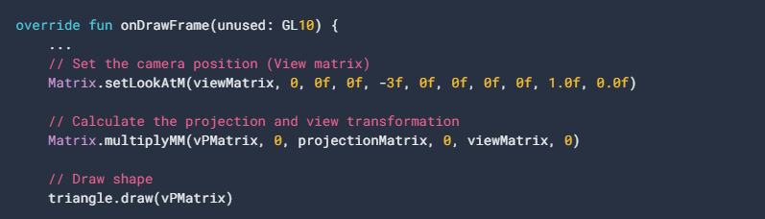
Camera View Code

Slide 27
Applying a Projection
In order to use the combined projection and camera view transformation matrix, the matrix variable must be added to the vertex shader.
The draw() method is modified to accept the combined transformation matrix and apply it to the shape.

Slide 28
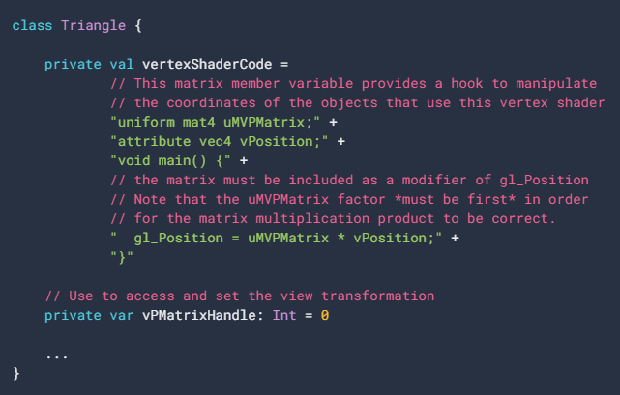
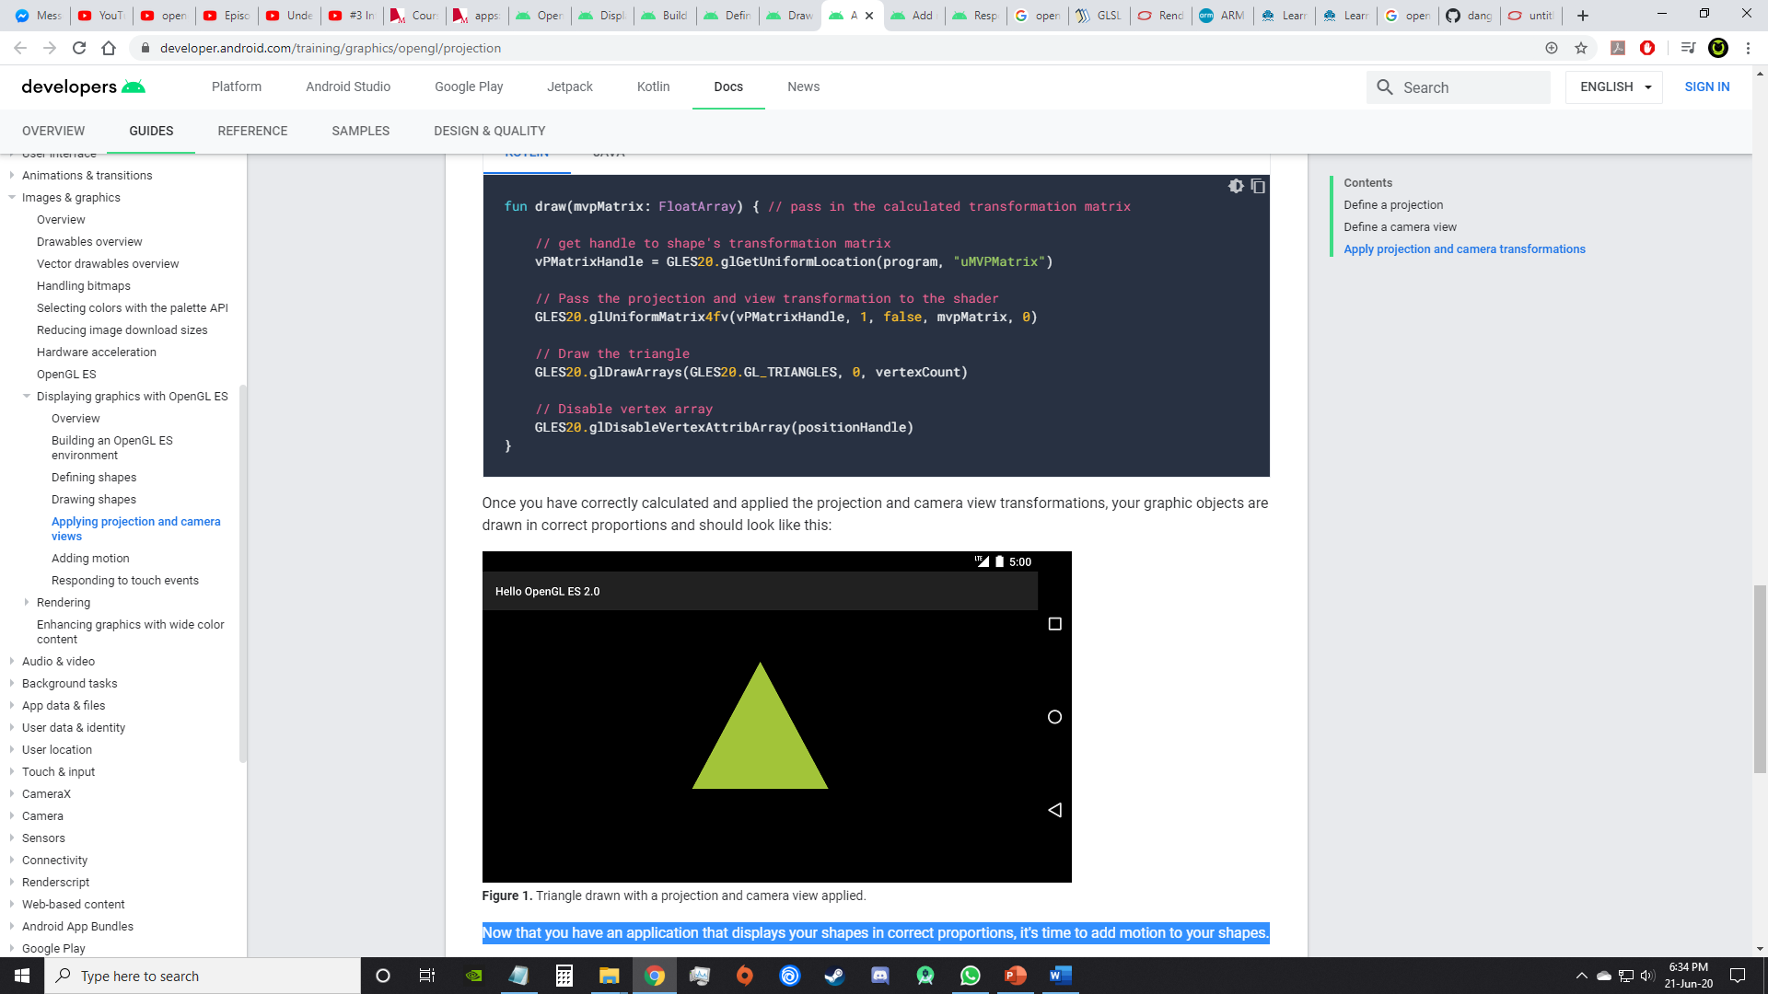
Applying Projection Code

Slide 29
Result

Slide 30
Motion and Touch
OpenGL ES provides additional capabilities for moving and transforming drawn objects in three dimensions.
Implementing a onTouchEvent() to listen for touch events.

Slide 31
END
Thank you for your attention!
Questions?

